Slide 1

Snehi sharma 1901010042 B.tech CSE VII sem House price Prediction System

Slide 2
USE OF HOUSE PRICE PREDICTION SYSTEM
House price prediction can help the developer determine the selling price of house and can help the customer to arrange the right time to purchase a house .There are three factors that influence the price of house which include physical conditions, concepts and location.
This project is to create a model which will predict the price for any new house by looking at the features we are given dataset with some features like numbers of bathrooms, bed rooms, drawing rooms , store rooms etc.and business objectives and goals, real estate company gets benefits from this Model.
We will use this model to predict house price in given area and we will invest in that area if its undervalued Manual experts who analyse previous prices of houses but, the prediction by the experts become wrong sometimes. They have 25% Error rate and the type of model – supervised, unsupervised , classification task regression task selecting a performance measure are typical performance measure for regression problem is the root mean square error (RMSE) its generally the preferred performance measure for regression task , so we choose it for the this particular problem we are solving for real estate pvt .Ltd. company.

Slide 3
Methods and regression applied in Model
In this project, we will be analysing the problem from collecting data, importing it to a jupyter notebook, looking for promising attributes, finding out correlations, plotting graphs, creating a pipeline, dealing with missing values and and concepts like cross validation, tain-test splitting, stratified shuffle split, cross validation and at the end we present the problem to the real estates company who will use the model for predicting house prices given a set of features.

Slide 4
ATTRIBUTE INFORMATION:
crim: per capita crime rate by town
zn: proportion of residential land zoned for lots over 25,000 sq.ft.
indus: proportion of non-retail business acres per town
chas: charles river dummy variable (= 1 if tract bounds river; 0 otherwise)
nox: nitric oxides concentration (parts per 10 million)
rm: average number of rooms per dwelling
age: proportion of owner-occupied units built prior to 1940
dis: weighted distances to five boston employment centres
rad: index of accessibility to radial highways
tax: full-value property-tax rate per $10,000
ptratio: pupil-teacher ratio by town
b: 1000(bk - 0.63)^2 where bk is the proportion of blacks by town
lstat: % lower status of the population
medv: median value of owner-occupied homes in $1000's
missing attribute values: none

Slide 5
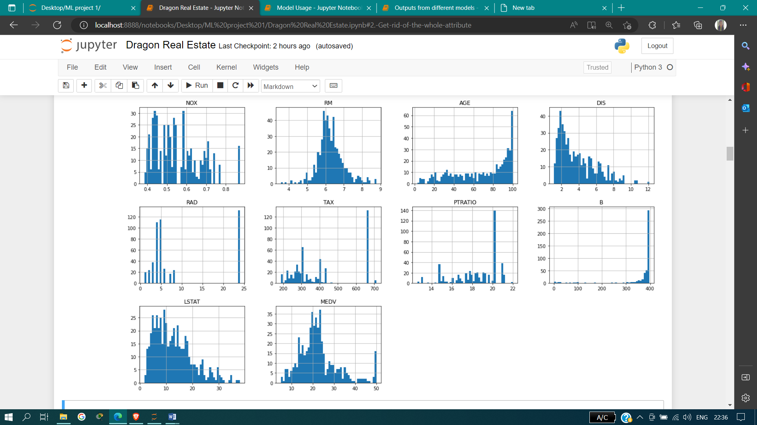
All features of houses are showing in the form of histogram graphs of houses with years

Slide 6
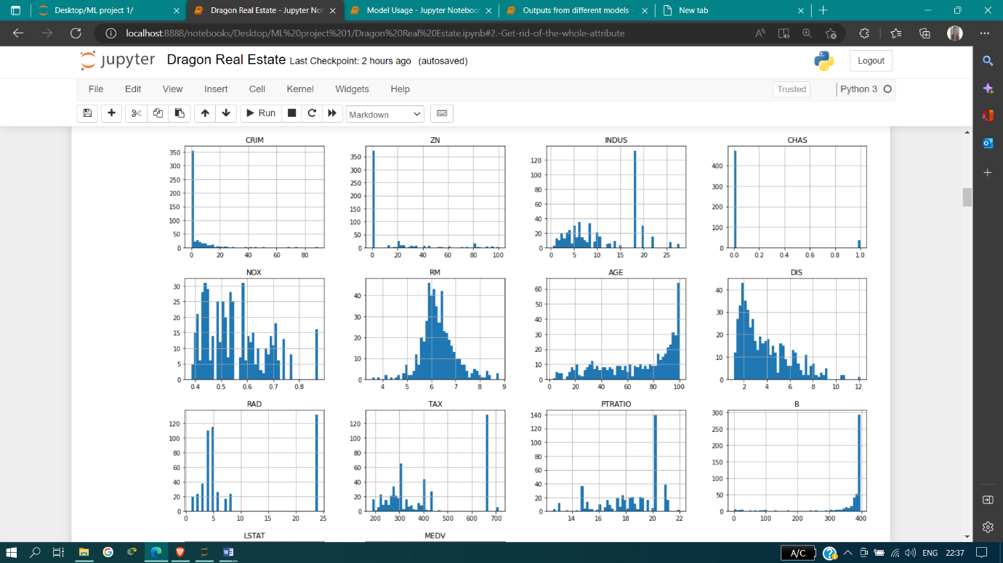
AGE – houses Age: proportion of owner-occupied units built prior to 1940 Chas: charles river dummy variable (= 1 if tract bounds river; 0 otherwise) Chas- categorical data (0-1) crim: per capita crime rate by town Medv: median value of owner-occupied homes in $1000's ex – 35$ house = 24lakhs INR training set – 405 testing set- 101

Slide 7
correlation
Correlation is a statistical measure that expresses the extent to which two variables are linearly related (meaning they change together at a constant rate). it’s a common tool for describing simple relationships without making a statement about cause and effect.
we describe correlations with a unit-free measure called the correlation coefficient which ranges from -1 to +1 means , – (one value is inc. then another value is also inc . its strong + correlation ) ( strong –ve correlation means when one value is inc. but another value is dec. with that ) and is denoted by r. statistical significance is indicated with a p-value.
the closer r is to zero, the weaker the linear relationship.
positive r values indicate a positive correlation, where the values of both variables tend to increase together.
negative r values indicate a negative correlation, where the values of one variable tend to increase when the values of the other variable decrease
100 = 0 in ZN
MEDV with LSTAT shows Highly (–Ve ) correlation means when LSTAT is dec then MEDV will Increase
RM with MEDV show highly + corr.

Slide 8
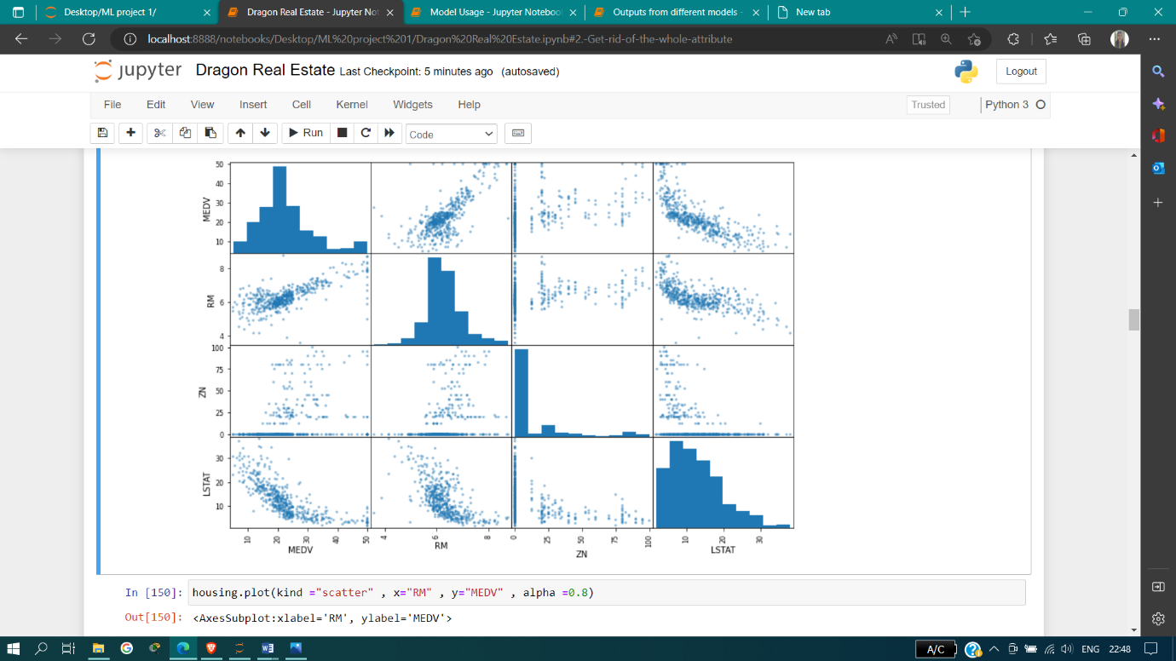
correlation

Slide 9
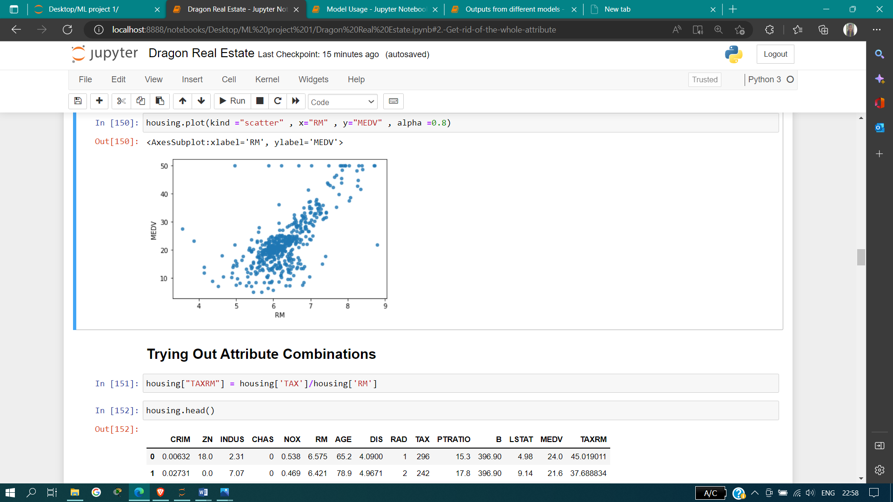
Scatter plot between MEDV and RM attributes

Slide 10
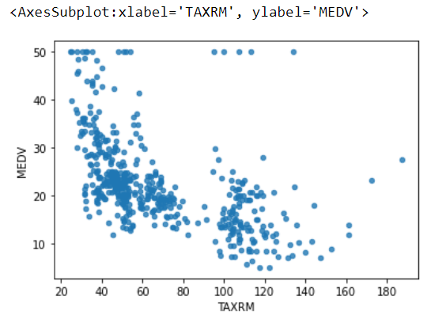
Scatter plot of “MEDV” with “TAXRM”
(it show strong (–ve)correlations)

Slide 11
Missing Attributes
To take care of missing attributes, you have Three options:
1. Get rid of the missing data points
2. Get rid of the whole attribute
3. Set the value to some value(0, mean or median)
Note: That the original housing dataframe will remain unchanged
Note : That there is No RM column and also note that the original housing dataframe will remain unchanged
(404, 12)

Slide 12
Creating Pipeline
Machine Learning pipeline is defined as a collection of preprocessing steps and a model. this means when raw data is passed to the ml pipeline, it preprocesses the data to the right format, scores the data using the model and pops out a prediction score
automating the machine learning workflow by enabling data to be transformed and correlated into model that can be analysed to achive outputs this type of ml pipeline makes the process of inputting data into the model fully automated.

Slide 13
Selecting a desired model for Real Estates
Random Forest Regressor
USING BETTER EVALUATION TECHNIQUE - CROSS VALIDATION
Cross-Validation is a technique for evaluating ml models by training several ml models on subsets of the available input data and evaluating them on the complementary subset of the data. use cross-validation to detect overfitting, ie, failing to generalize a pattern.
cross-validation is a technique for validating the model efficiency by training it on the subset of input data and testing on previously unseen subset of the input data. it is a technique to check how a statistical model generalizes to an independent dataset

Slide 14
MODEL OUTPUTS:
1. Decision Tree:
mean: 4.189504502474483
standard deviation: 0.848096620323756
2. Linear Regression:
mean: 4.221894675406022
standard deviation: 0.7520304927151625
This method is the best for this house price prediction because it gives least rmse value.
3. Random Forest Regression:
mean: 3.494650261111624
standard deviation: 0.762041223886678

Slide 15
from joblib import dump, load
import numpy as np
model,pipe = load('Dragon.joblib')
features = np.array([[-1.43942006, -0.12628155, -0.6165014, -0.67288841, -0.42262747,
-1.44443979304, -0.31238772, 0.61111401, -0.0016879 , -0.5778192 ,
-0.97491834, 0.41164221, -0.86091034]])
model.predict(features)
Output
array([22.754])

Slide 16
REFERENCE
https://inria.github.io/scikit-learn-mooc/python_scripts/cross_validation_stratification.html
https://scikit-learn.org/stable/
https://scikit-learn.org/stable/modules/generated/sklearn.impute.simpleimputer.html
https://scikit-learn.org/stable/modules/impute.html
https://www.w3schools.com/python/python_variables_names.asp
real estate - jupyter notebook

Slide 17
Thank You

